Slide 1

Programming with JavaScript and jQuery
Day 3
Chapter 5:
Working with the Document Object Model (DOM) & DHTML

Slide 2
Understanding the Browser Object Model and the Document Object Model
JavaScript treats web page content as set of related components (objects).
Every element on a web page is an object.
You can also create objects within a JavaScript app.

Slide 3
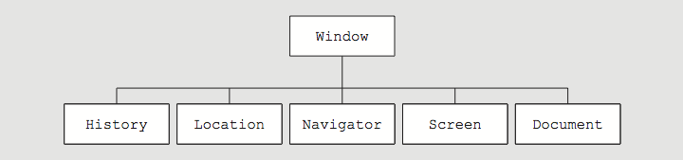
Understanding the Browser Object Model
Browser object model (BOM) or client-side object model
Hierarchy of objects
Each provides programmatic access to a different aspect of the web browser window or the web page
Window object
Represents a Web browser window
Called the global object
Because all other BOM objects contained within it
Figure 5-3 Browser object model

Slide 4
The Document Object Model
Document object
Represents the Web page displayed in a browser
Contains all of the Web page elements
JavaScript represents each element by its own object

Slide 5
The DOM and DHTML
Dynamic HTML (DHTML)
Interaction can change content of web page without reloading
Can also change presentation of content
Combination of HTML, CSS, and JavaScript
DOM
example of an application programming interface (API)
structure of objects with set of properties and methods

Slide 6
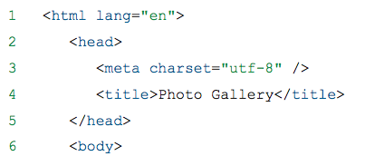
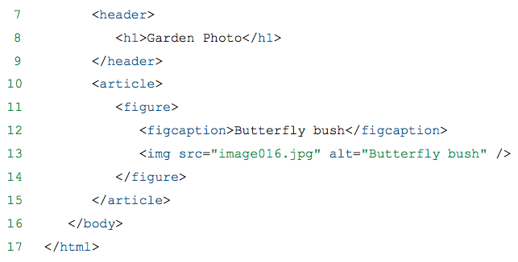
The DOM tree
The DOM hierarchy depends on a document's contents

Slide 7
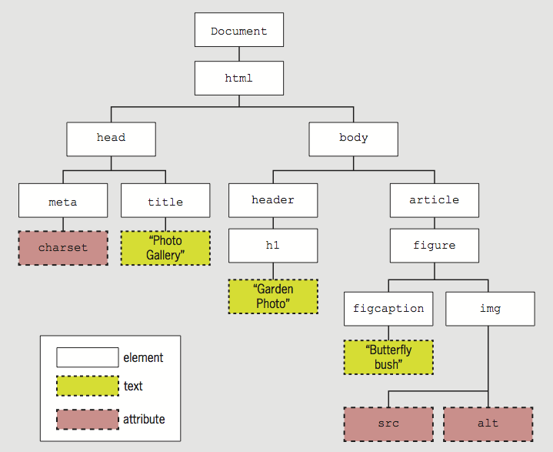
The DOM tree
Figure 5-4 Example DOM tree

Slide 8
The DOM tree
A node is a generic reference to an element, an attribute, or a string of text.
Each item in the DOM tree is a node
Element, attribute, and text content nodes are most commonly used
Which item(s) in Figure 5-4 are Objects?
Which item(s) in Figure 5-4 are Nodes?
What is the difference between Objects and Nodes?

Slide 9
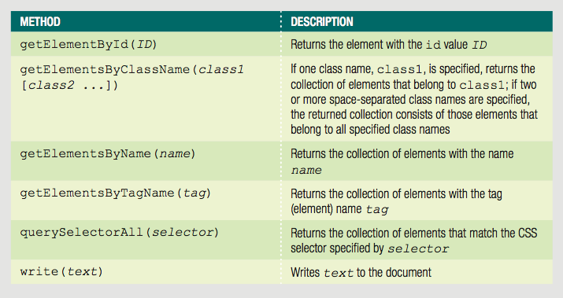
DOM Document Object Methods
Table 5-1 HTML DOM Document object methods

Slide 10
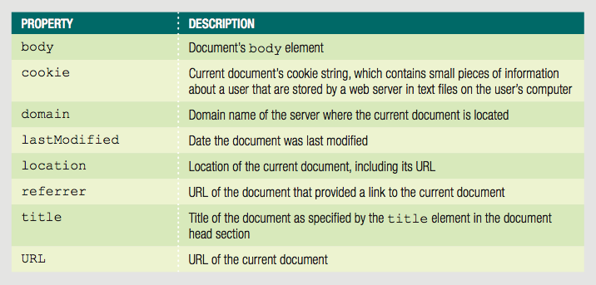
DOM Document Object Properties
Table 5-2 Selected DOM Document object properties

Slide 11
Short Quiz 1
What is the Window object?
What is the DOM?
What is the difference between the Window object and the Document object? What is the relationship between the two?

Slide 12
Accessing Document Elements, Content, Properties, and Attributes
Methods such as getElementById() are methods of the Document object
Several methods available for JavaScript to reference web page elements

Slide 13
Accessing Elements by id value
Set the id value in HTML
getElementById() method
Returns the first element in a document with a matching id attribute
Example:
HTML element with id value
<input type="number" id="zip" />
JavaScript to reference HTML element
var zipField = document.getElementById("zip");

Slide 14
Accessing Elements by Tag Name
getElementsByTagName() method
Returns array of elements matching a specified tag name
Tag name is name of element
Method returns a set of elements
Node list is indexed collection of nodes
HTML collection is indexed collection of HTML elements
Either set uses array syntax
What is an indexed collection? How can you access elements in an indexed collection?

Slide 15
Accessing Elements by Tag Name
Example:
Index numbers start at 0, so second element uses index number 1
To work with the second h1 element on a page:
var secondH1 = document.getElementsByTagName("h1")[1];

Slide 16
Accessing Elements by Class Name
getElementsByClassName() method
Returns node list or HTML collection of elements with a class attribute matching a specified value
Example
All elements with class value side:
var sideElements = document.getElementsByClassName("side");

Slide 17
Accessing Elements by Class Name
class attribute takes multiple values, so getElementsByClassName() method takes multiple arguments
Arguments enclosed in single set of quotes, with class names separated by spaces
Example
All elements with class values side and green:
var sideGreenElements = document.getElementsByClassName("side green");

Slide 18
Accessing Elements by Name
getElementsByName() method
Returns node list or HTML collection of elements with a name attribute matching a specified value
Not as useful as preceding options
But creates more concise code when accessing set of option buttons or check boxes in a form:
Not standard in IE9 and earlier versions of IE, so it is important to test
var colorButtons = document.getElementsByName("color");

Slide 19
Accessing Elements with CSS Selectors
querySelector() method
References elements using CSS syntax
Returns first occurrence of element matching a CSS selector
Example:
HTML:
^{<header>}
<h1><img class="logo" src="images/logo.png"↵
alt="Blue Jay Photography" /></h1>
^{</header>}
JavaScript to reference the img element
^{querySelector("header h1 img")}

Slide 20
Accessing Elements with CSS Selectors
querySelectorAll() method
Returns collection of elements matching selector
Different from querySelector() method, which returns only first occurrence
Example:
HTML:
^{<nav>}
^{<ul>}
^{<li>About Us</li>}
^{<li>Order</li>}
^{<li>Support</li>}
^{</ul>}
^{</nav>}
JavaScript to reference all three li elements:
^{querySelectorAll("nav ul li")}

Slide 21
Accessing an Element's Content
textContent property
Accesses and changes text that an element contains
Unlike innerHTML, textContent strips out HTML tags
Example:
HTML:
^{<ul>}
<li class="topnav"><a href="aboutus.htm">About Us</a></li>
<li class="topnav"><a href="order.htm">Order</a></li>
<li class="topnav"><a href="support.htm">Support</a></li>
^{</ul>}
JavaScript to reference and access first li element:
var button1 = querySelectorAll("li.topNav")[0];
var allContent = button1.innerHTML;
// <a href="aboutus.htm">About Us</a>
var justText = button1.textContent;
^{// About Us}

Slide 22
Accessing an Element's Content
textContent property is more secure
Not supported by IE8 or earlier
Some developers use if/else construction to implement textContent only on supported browsers

Slide 23
Accessing an Element's CSS Properties
You can access CSS properties through DOM
Use dot notation
Reference element's style property followed by name of CSS property
Example: change value of CSS display property to none for element with id value logo:
document.getElementById("logo").style.display = "none";

Slide 24
Accessing an Element's CSS Properties
When CSS property includes hyphen (-), remove hyphen and capitalize letter following hyphen
Use dot notation
font-family becomes fontFamily
Example:
CSS value specified using DOM reference is an inline style
Higher priority than embedded or external styles
Why can you not use hyphens when referencing DOM elements?
var font = document.getElementById("logo").style.fontFamily;

Slide 25
Accessing an Element's CSS Properties
To remove a style you previously added with a DOM reference
set its value to an empty string
Example:
document.getElementById("navbar").style.color = "";

Slide 26
Accessing Element Attributes
Access element attribute with period and name of attribute after element reference
Reference element with id value homeLink:
Reference href attribute of same element:
Can use to look up attribute value and assign to variable, or to assign new value to attribute
document.getElementById("homeLink")
document.getElementById("homeLink").href

Slide 27
Accessing Element Attributes
One exception for accessing element attributes
Must use property name className to refer to class attribute values
Single class value returned like standard attribute value
Multiple class values returned in single string, separated by spaces

Slide 28
Short Quiz 2
What statement would you use to create a variable named logo and assign as its value a reference to the element with the id value logoImage?
What statement would you use to create a variable named firstPriority and assign as its value a reference to the first li element in the document?
What statement would you use to create a variable named language and assign as its value the value of the lang attribute of the html element?

Slide 29
Adding and Removing Document Nodes
DOM includes methods to change DOM tree
Can create brand new elements
Can add/remove elements from DOM tree

Slide 30
Creating Nodes
createElement() method
Creates a new element
Syntax:
element is an element name
Example:
To create a new div element:
document.createElement("element")
^{document.createElement("div");}

Slide 31
Attaching Nodes
Newly created node is independent of DOM tree
appendChild() method
Attaches node to DOM tree
Syntax:
childNode is node to be attached
parentNode is node to attach child node to
parentNode.appendChild(childNode)

Slide 32
Attaching Nodes
Example:
Create new li element and attach to element with id value navList:
Document fragment
Set of connected nodes not part of document
Can use appendChild() to add document fragment to DOM tree for a document
var list = document.getElementById("navList");
var contact = document.createElement("li");
^{list.appendChild(contact);}

Slide 33
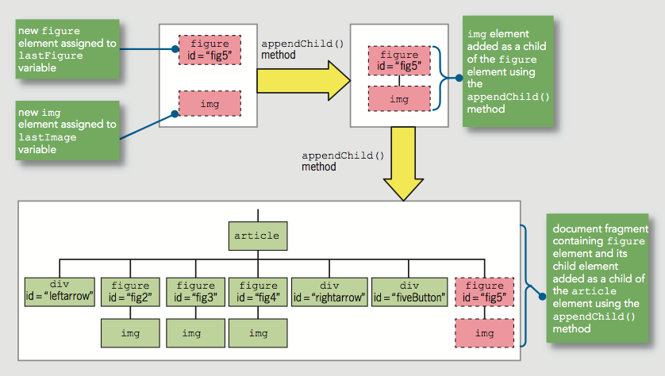
Attaching Nodes
Table 5-7 Using the appendChild() method to attach nodes

Slide 34
Cloning Nodes
Create new node same as existing node
cloneNode() method
Syntax:
existingNode.cloneNode(true | false)
true argument clones child nodes
false argument clones only specified parent node
Example:
^{document.createElement("div");}

Slide 35
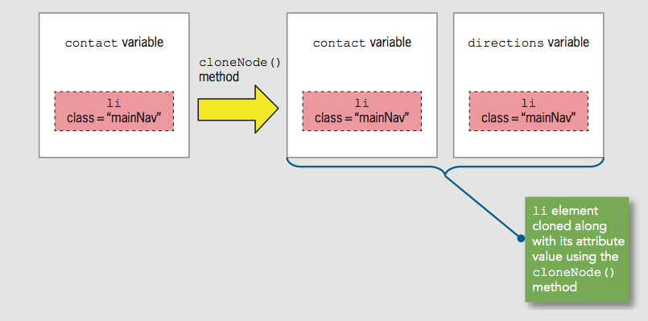
Cloning Nodes
Example:
var contact = document.createElement("li");
^{contact.className = "mainNav";}
var directions = contact.cloneNode(true);
Figure 5-10 Using the cloneNode() method

Slide 36
Inserting Nodes at Specific Positions in the Document Tree
New node created with createElement() is not attached to document tree
appendChild() adds node after existing child nodes
To specify a different position, use insertBefore()
Syntax:
parentNode.insertBefore(newChildNode, existingChildNode)

Slide 37
Inserting Nodes at Specific Positions in the Document Tree
Example:
HTML:
JavaScript:
^{<ul id="topnav">}
<li><a href="aboutus.htm">About Us</a></li>
<li><a href="order.htm">Order</a></li>
<li><a href="support.htm">Support</a></li>
^{</ul>}
var list = document.getElementById("topnav");
var directions = document.createElement("li");
directions.innerHTML = "Directions";
var aboutus = document.querySelectorAll("#topnav li")[0];
list.insertBefore(directions, aboutus);

Slide 38
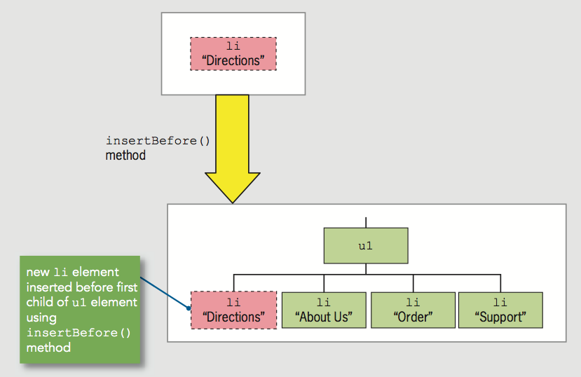
Inserting Nodes at Specific Positions in the Document Tree
Figure 5-14 Using the insertBefore() method

Slide 39
Removing Nodes
removeNode() removes node from DOM tree
Syntax:
parentNode.removeChild(childNode)
Can assign removed node to variable:
Node removed without being assigned to a variable is deleted during garbage collection
var list = document.getElementById("topnav");
var aboutus = document.querySelectorAll("#topnav li")[0];
var aboutNode = list.removeChild(aboutus);

Slide 40
Short Quiz 3
What statement creates a new footer element?
Name two methods you can use to add a node to the DOM tree, and explain the difference between them.
How would the results of the following 2 statements differ:
drive.cloneNode(true);
drive.cloneNode(false);

Slide 41
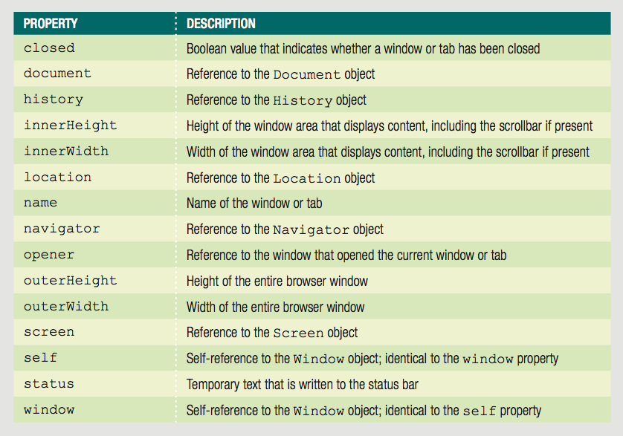
Manipulating the Browser with the Window Object
Window object
Includes properties containing information about the web browser window or tab
Contains methods to manipulate the web browser window or tab itself
Table 5-3 Window object properties

Slide 42
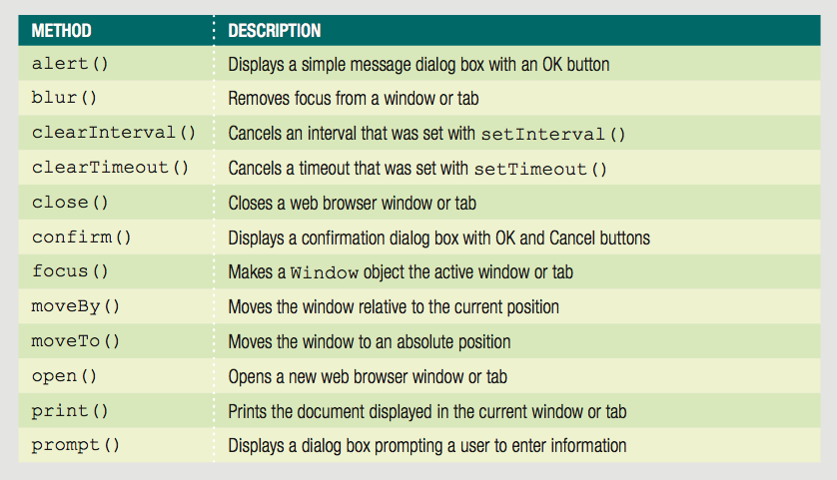
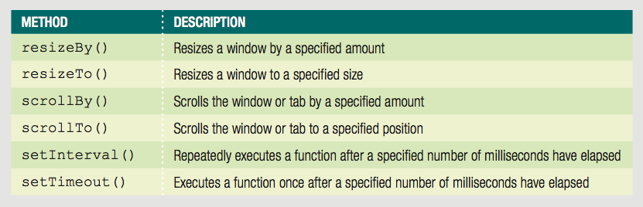

Slide 43
Manipulating the Browser with the Window Object
self property
Refers to the current Window object
Identical to using the window property to refer to the Window object
Examples:
^{window.close();}
^{self.close();}
Web browser assumes reference to global object
Good practice
Use window or self references
When referring to a Window object property or method

Slide 44
Opening and Closing Windows
Reasons to open a new Web browser window
To launch a new Web page in a separate window
To use an additional window to display information
When new Web browser window opened:
New Window object created
Represents the new window
Know how to open a link in a new window using the a element’s target attribute
<a href="http://www.wikipedia.org/"↵
target="wikiWindow">Wikipedia home page</a>

Slide 45
Opening a Window
open() method of the Window object
Opens new windows
Syntax
window.open(url, name, options, replace);
Table 5-5 Arguments of the Window object’s open() method

Slide 46
Opening a Window
Include all (or none) window.open() method arguments
Example:
window.open("http://www.wikipedia.org");

Slide 47
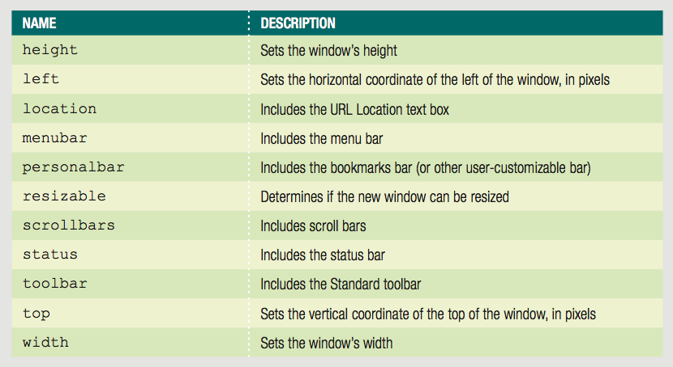
Opening a Window
Customize new browser window or tab appearance
Use window.open() method options argument
Table 5-6 Common options of the Window object’s open() method

Slide 48
Opening a Window
window.open() method name argument
Same as value assigned to the target attribute
Specifies window name where the URL should open
If name argument already in use
JavaScript changes focus to the existing Web browser window instead of creating a new window

Slide 49
Opening a Window
Window object’s name property used to specify a target window with a link
Cannot be used in JavaScript code
Assign the new Window object created with the window.open() method to a variable to control it
focus() method
Makes a window the active window

Slide 50
Closing a Window
close() method
Closes a web browser window
window.close() or self.close()
Closes the current window

Slide 51
Working with Timeouts and Intervals
Window object’s timeout and interval methods
Creates code that executes automatically
setTimeout() method
Executes code after a specific amount of time
Executes only once
Syntax
var variable = setTimeout("code", milliseconds);
clearTimeout() method
Cancel setTimeout() before its code executes
Example on next slide

Slide 52
Working with Timeouts and Intervals
var buttonNotPressed = setTimeout("window.alert('Your↵
changes have been saved')",10000);
^{function buttonPressed() {}
clearTimeout(buttonNotPressed);
^{window.open(index.htm);}
}

Slide 53
Working with Timeouts and Intervals
setInterval() method
Repeatedly executes the same code after being called only once
Syntax:
var variable = setInterval("code", milliseconds);
clearInterval() method
Used to clear setInterval() method call

Slide 54
Short Quiz 4
What statement do you use to create a new blank window?
What happens if your apps include JavaScript code that opens a new window or tab without a request from the user?
What extra step do you need to take in code to create a new window if you want to be able to control the new window FROM the window that created it?

Slide 55
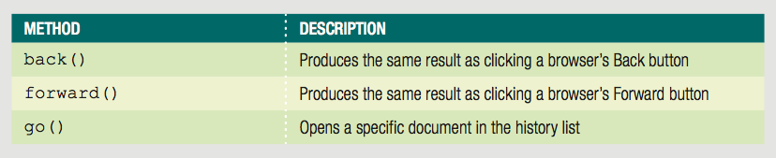
The History Object
History object
Maintains internal list (history list)
All documents opened during current web browser session
Security features
Will not display URLs contained in the history list
Table 5-7 Methods of the History object

Slide 56
The History Object
go() method
Allows navigation to a specific previously visited web page
History object length property
Provides specific number of documents opened during the current browser session
Example:
Return to first document opened in current browser session:
history.go(-(history.length - 1));

Slide 57
The Location Object
Location object
Allows changes to a new web page from within JavaScript code
Location object properties allow modification of URL individual portions
Web browser automatically attempts to open that new URL

Slide 58
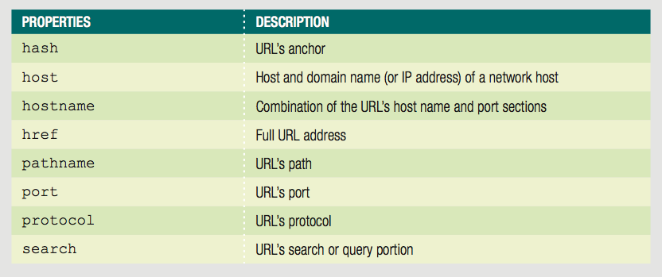
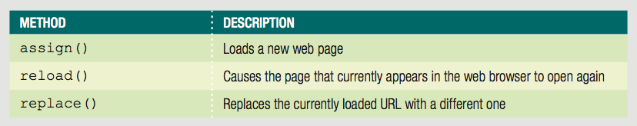
The Location Object
Table 5-8 Properties of the Location object
Table 5-9 Methods of the Location object

Slide 59
The Location Object
Location object’s assign() method
Same action as changing the href property
Loads a new web page
Location object’s reload() method
Equivalent to the browser Reload or Refresh button
Causes current page to open again
Location object’s replace() method
Replaces currently loaded URL with a different one

Slide 60
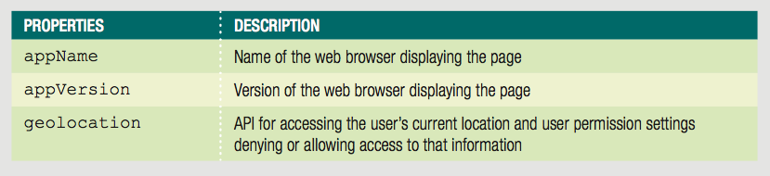
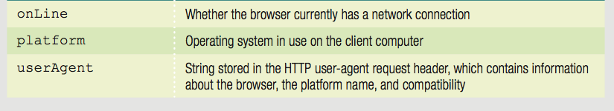
The Navigator Object
Navigator object
Obtains information about current web browser
Example: determine type of web browser running
Table 5-10 Properties of the Navigator object

Slide 61
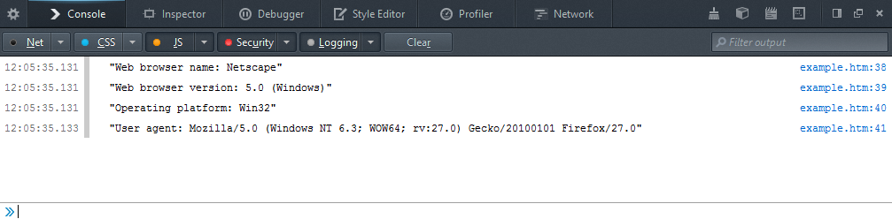
The Navigator Object
console.log("Web browser name: " + navigator.appName);
console.log("Web browser version: " + navigator.appVersion);
console.log("Operating platform: " + navigator.platform);
console.log("User agent: " + navigator.userAgent);
Figure 5-19 Navigator object properties in Firefox console

Slide 62
The Screen Object
Screen object
Obtains information about display screen’s size, resolution, color depth
Common use of Screen object properties
Centering a web browser window in the middle of the display area

Slide 63
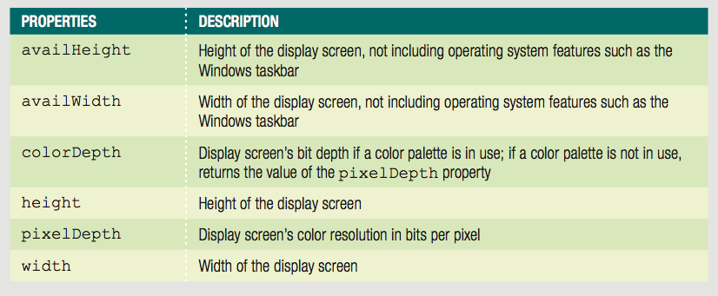
The Screen Object
Table 5-11 Properties of the Screen object

Slide 64
The Screen Object
Common Screen object properties uses
Center a web browser window
Example:
^{var winWidth = 300;}
^{var winHeight = 200;}
var leftPosition = (screen.width - winWidth) / 2;
var topPosition = (screen.height - winHeight) / 2;
var optionString = "width=" + winWidth + ",height="
+ winHeight + ",left=" + leftPosition + ",top=" + topPosition;
var openWin = window.open("", "CtrlWindow", optionString);

Slide 65
Short Quiz 5
Provide two statements that display the previous page in the browser history.
What is the effect of the statement:
location.reload(true);
What types of information can you access using the Screen object?

Slide 66
Summary
Browser object model (BOM) or client-side object model
Hierarchy of objects
Top-level object in the browser object model
Window object
Document object: most important object
DOM represents web page displayed in window

Slide 67
Summary
Access elements with getElementById(), getElementsByTagName(), getElementsByClassName(), getElementsByName, querySelector(), or querySelectorAll()
Access element content with textContent() or innerHTML() property
Access CSS properties using an element's JavaScript style property

Slide 68
Summary
Create new node with createElement()
Attach node with appendChild()
Clone node with cloneNode()
Attach node in specific place with insertBefore()
Remove node with removeNode()
Open new window with window.open()
Close window with window.close()

Slide 69
Summary
setTimeout() executes code after specific amount of time
clearTimeout() cancels setTimeout()
setInterval() executes code repeatedly
clearInterval() cancels setInterval()

Slide 70
Summary
History object maintains an opened documents history list
Location object allows changes to a new web page from within JavaScript code
Navigator object obtains information about the current web browser
Screen object obtains information about the display screen’s size, resolution, color depth

